Slide 1
Data Analytics Bootcamp
Kasunmali Dasunrusiri Liyanage
malirusiri@gmail.com
GitHub repository link: https://github.com/KasunmaliL/Analyzing-Google-Play-Store-App-Trends-using-Python-Power-BI.git

Slide 2
AGENDA
Day 1: Data Loading & Cleaning
Day 2: Exploratory Data Analysis (EDA)
Day 3: Dashboard Creation (Power BI)

Slide 3
Day 1 – Data Loading & Cleaning
• Imported Google Play Store dataset using KaggleHub in Python.
• Inspected data using .info(), .describe() and handled missing values.
• Cleaned text-based numeric columns (Price, Installs, Reviews).
• Converted data types, removed duplicates, and filtered invalid ratings (>5).
• Added a derived column 'isPaid' (1 = Paid, 0 = Free).
• Saved cleaned dataset as 'cleaned_playstore.csv'.

Slide 4
Day 2 – Exploratory Data Analysis (EDA)
• Loaded cleaned dataset for visualization and insights.
• Identified top app categories and their distribution.
• Visualized rating trends using bar plots, histograms, and scatter plots.
• Performed correlation analysis between Rating, Reviews, Installs, and Price.
• Exported EDA summary as 'eda_summary.csv'.

Slide 5
Key Insights
• 'Family', 'Game', and 'Tools' are the most popular app categories.
• Paid apps tend to have slightly higher ratings than free apps.
• Number of Reviews strongly correlates with Installs.
• Price shows a weak negative correlation with Installs.
• Most apps have ratings between 4.0 and 4.5, showing high user satisfaction.

Slide 6
Day 3: Dashboard creation using powerbi
• Uploaded 'cleaned_playstore.csv' to Power BI Web.
• Created visuals:
- Bar Chart: Top 10 app categories by count
- Donut Chart: Free vs Paid app distribution
- Line Chart: Average rating by category
- KPI Cards: Average of Rating, Average of Price, Average of Reviews, Average of Installs
• Added captions and consistent professional color theme.
• Dashboard file: 'Dashboard Creation.pbix'

Slide 7
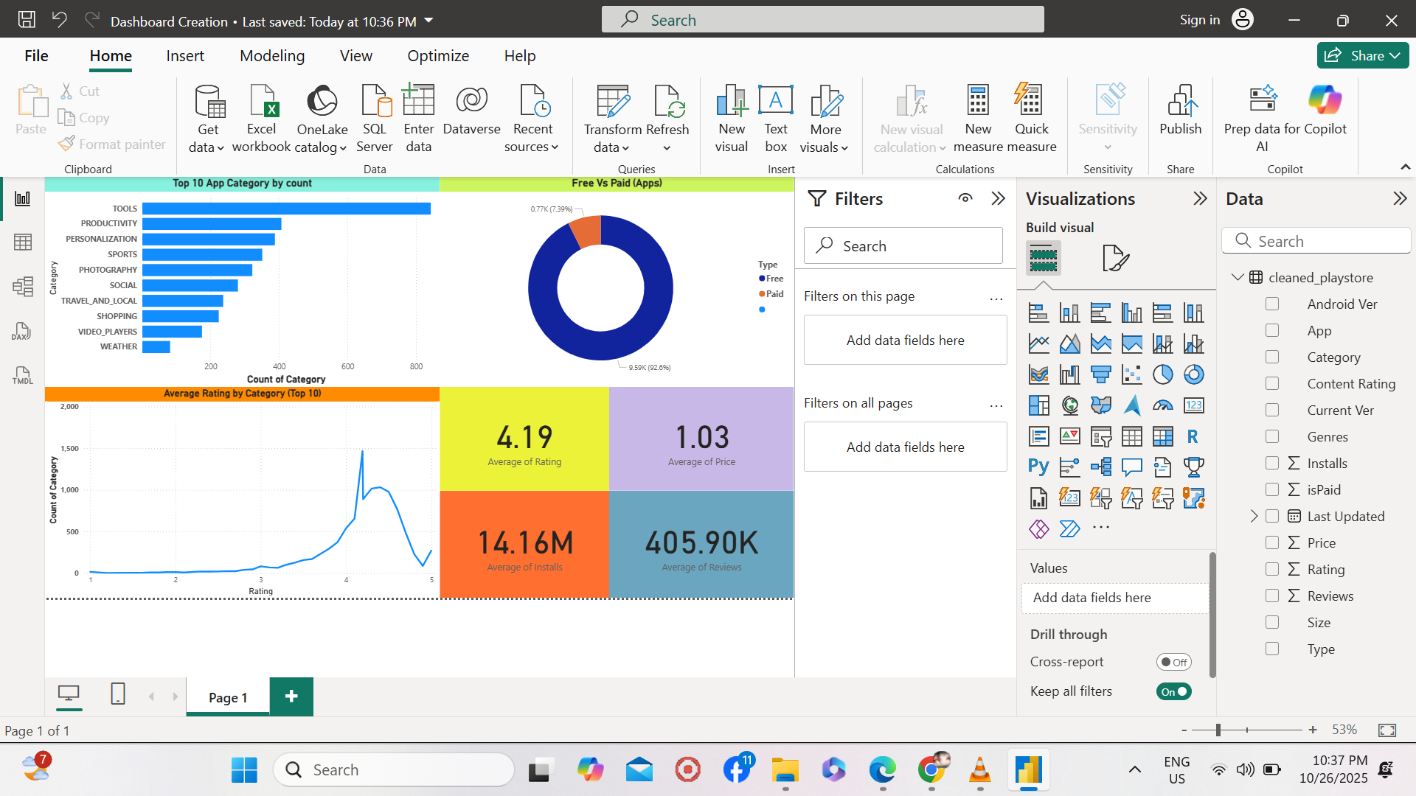
Dashboard using power BI

Slide 8
What I Learned from This Bootcamp
• End-to-end data analytics workflow using Python and Power BI.
• Data cleaning and preprocessing using Pandas and NumPy.
• Data visualization using Matplotlib and Seaborn.
• Dashboard creation and KPI tracking in Power BI.
• Translating raw data into meaningful business insights.

Slide 9
Conclusion
This project enhanced my understanding of data analysis from cleaning to visualization.
I successfully applied industry-relevant tools (Python, Power BI) for end-to-end analysis.
It improved my ability to interpret data and present insights effectively.
Project completed under DevTown Data Analytics Bootcamp.

Slide 10
THANK YOU

